Slide 1
Physics from symmetry
As far as I see, all a priori statements in physics have their origin in symmetry – Hermann Weyl
The truth always turns out to be simpler than you thought – Richard P. Feynman
The most beautiful thing in physics is when something incomprehensible, suddenly becomes comprehensible, because of a deep explanation.
There is presently NO theory that is able to derive the constants of nature. These constants need to be extracted from experiments

Slide 2
Special relativity: the velocity of light has the same value in all inertial frames of reference, which are frames moving with constant velocity relative to each other and physics is the same in all inertial frames of reference.
The set of all transformations permitted by these symmetry constrains is called the Poincaré group.
Lagrangian must be invariant (= does not change) under any transformation of the Poincaré group
Symmetry breaking and a special way to break symmetries called the Higgs mechanism, which enables us to describe particles with mass.
Noether’s theorem reveals a deep connection between symmetries and conserved quantities.
The standard model uses quantum field theory to describe the behavior of all known elementary particles.

Slide 3
Elementary Particles
Bosons (integer spin, mostly 1)
For the forces of nature
1. Electromagnetic interactions – massless photons – need charge: electric charge
2. Weak force – massive W+, W-, Z- bosons – need charge: isospin (all fermions have )
3. Strong force – massless gluons – need charge: color
4. Gravity – (maybe) gravitons
Higgs boson (spin 0)
Fermions (half-integer spin)– Pauli’s exclusion principle
Responsible for matter
Atoms consist of electrons (are leptons), protons (consist of quarks), and neutrons (consist of quarks) (all fermions)

Slide 4
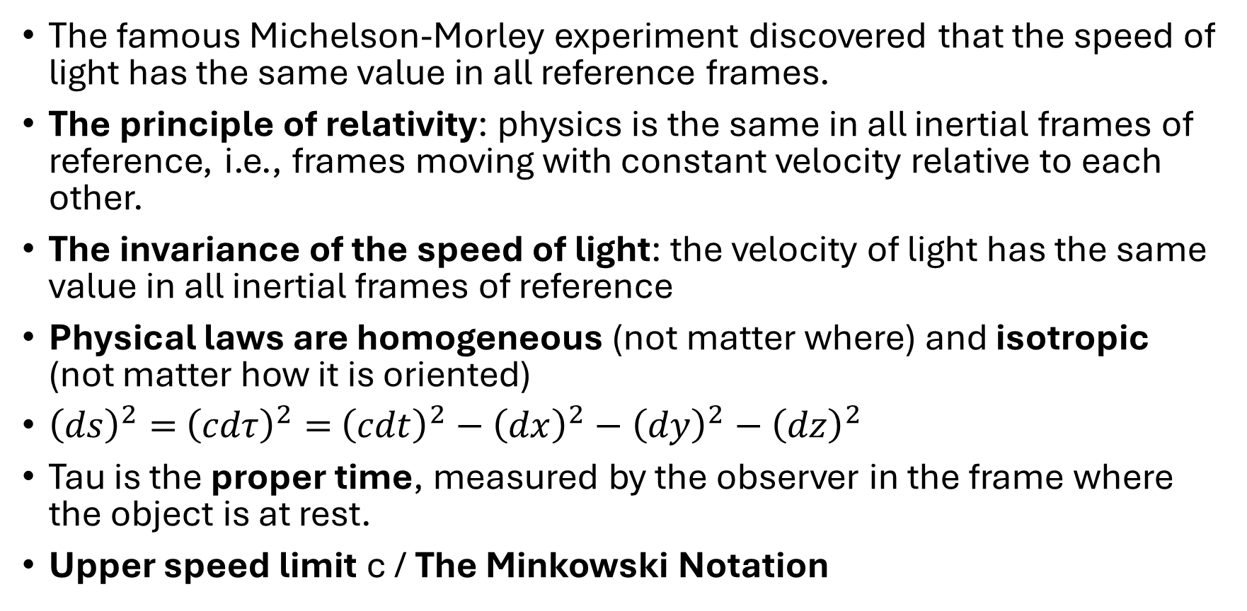
2. Special relativity
The famous Michelson-Morley experiment discovered that the speed of light has the same value in all reference frames.
The principle of relativity: physics is the same in all inertial frames of reference, i.e., frames moving with constant velocity relative to each other.
The invariance of the speed of light: the velocity of light has the same value in all inertial frames of reference
Physical laws are homogeneous (not matter where) and isotropic (not matter how it is oriented)
${\left(ds\right)}^{2}=$ ${\left(cdτ\right)}^{2}=$ ${\left(cdt\right)}^{2}−{\left(dx\right)}^{2}−{\left(dy\right)}^{2}−{\left(dz\right)}^{2}$
Tau is the proper time, measured by the observer in the frame where the object is at rest.
Upper speed limit c / The Minkowski Notation

Slide 5
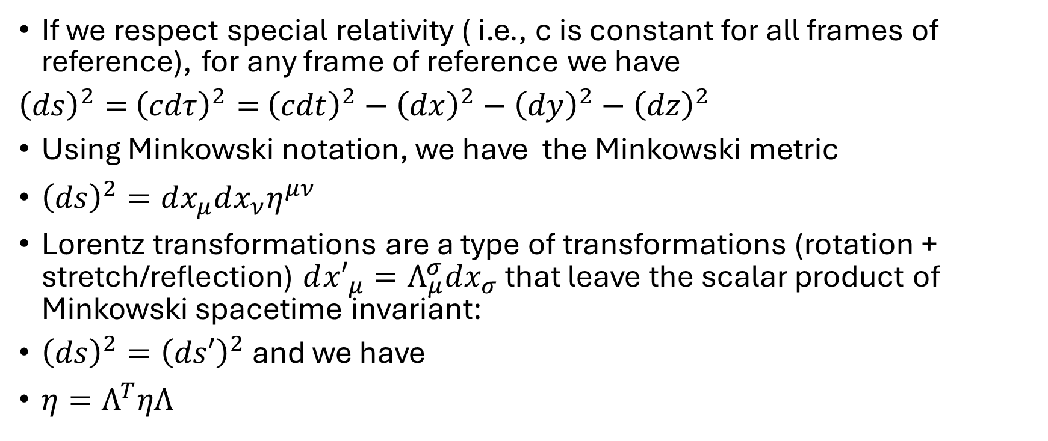
Special relativity to Minkowski notation to Lorenz transformations
If we respect special relativity ( i.e., c is constant for all frames of reference), for any frame of reference we have
${\left(ds\right)}^{2}=$ ${\left(cdτ\right)}^{2}=$ ${\left(cdt\right)}^{2}−{\left(dx\right)}^{2}−{\left(dy\right)}^{2}−{\left(dz\right)}^{2}$
Using Minkowski notation, we have the Minkowski metric
${\left(ds\right)}^{2}=dx_{μ}dx_{ν}η^{μν}$
Lorentz transformations are a type of transformations (rotation + stretch/reflection) $d{x′}_{μ}=Λ_{μ}^{σ}dx_{σ}$ that leave the scalar product of Minkowski spacetime invariant:
${\left(ds\right)}^{2}={\left(ds′\right)}^{2}$ and we have
$η=Λ^{T}ηΛ$

Slide 6
We call something invariant, if it doesn’t change under transformations
Symmetry is defined as invariance under a set of transformations
Covariance means something takes the same form (but can have different parameters)
All physical laws must be covariant under Lorentz transformations

Slide 7
Part II symmetry tools: Lie Group Theory
‘Numbers measure size, groups measure symmetry’ – Mark A. Armstrong
The Poincaré group is the Lorentz group (rotation and stretch) plus translations
Group theory – Mathematics that deals with symmetries
Lie group theory - Mathematics that deals with continuous symmetries (the transformation parameters like rotation angle is continuous, not discrete)
A group is a collection of transformations (completely independent of the object the transformations act on) with a binary operation that satisfies four fundamental axioms (closure, associativity, identity, and inverse)
Symmetry is defined as the idea that invariance (something is invariant) under a set of transformations
The combination of transformations must be associative (associativity), but not commutative.
Representation theory deals with different descriptions of the same transformations
The set of all transformations that leave a give object invariant is called a symmetry group

Slide 8
Group theory
Isomorphism between SO(2) (matrix representation) and U(1) (complex number representation)
We use Quaternions (4D complex numbers)as tool to describe rotations in 3D. Take note that unit quaternions have exactly 3 degrees of freedom.
ijk=-1, ij=k, ki=j, jk=I, ji=-k, kj=-I, ik=-j

Slide 9
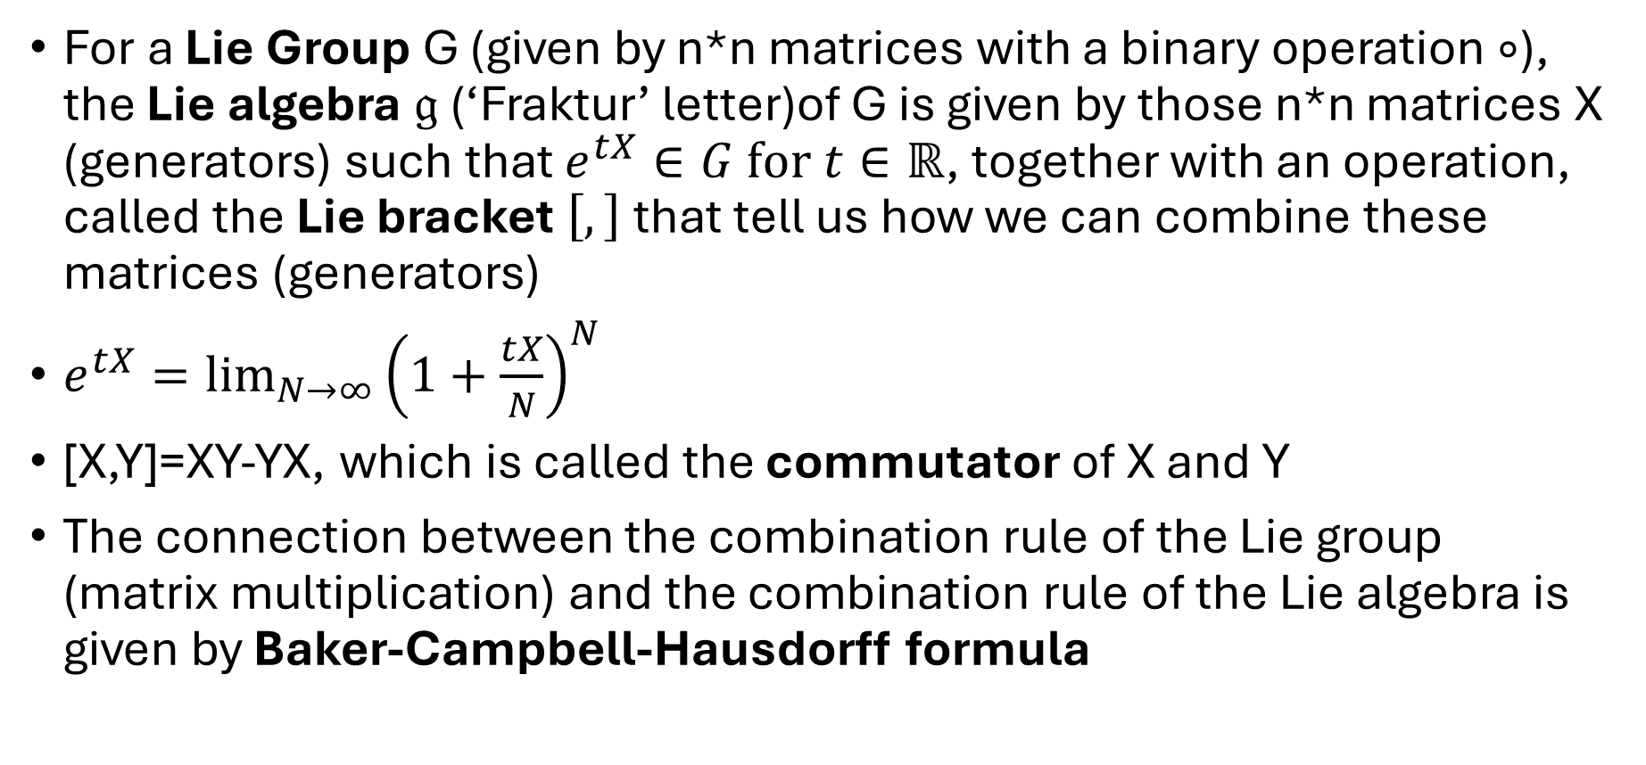
Lie Group
For a Lie Group G (given by n*n matrices with a binary operation$∘$), the Lie algebra $𝔤$ (‘Fraktur’ letter)of G is given by those n*n matrices X (generators) such that $e^{tX}∈G for t∈ℝ$, together with an operation, called the Lie bracket $\left[,\right]$ that tell us how we can combine these matrices (generators)
$e^{tX}=\lim_{N→∞}{{\left(1+\frac{tX}{N}\right)}^{N}}$
[X,Y]=XY-YX, which is called the commutator of X and Y
The connection between the combination rule of the Lie group (matrix multiplication) and the combination rule of the Lie algebra is given by Baker-Campbell-Hausdorff formula

Slide 10
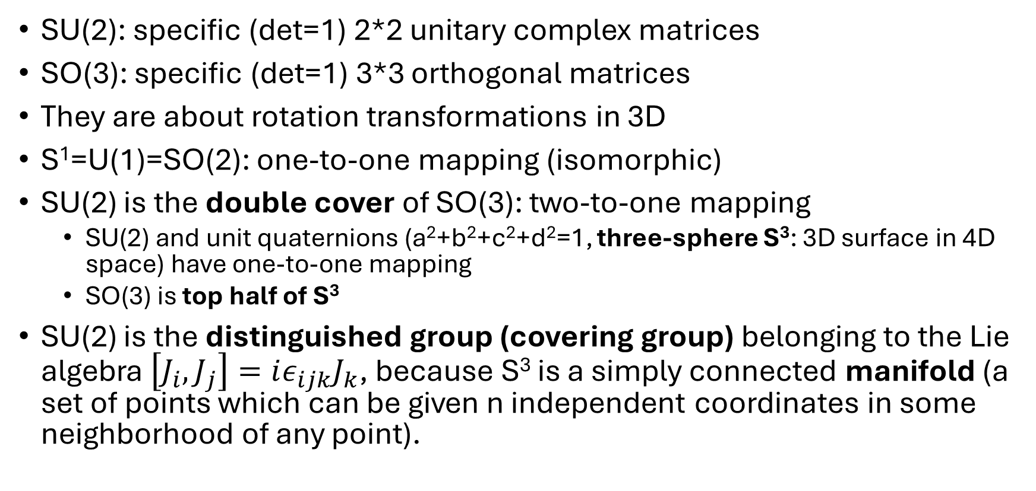
SU(2) and SO(3) have the same Lie bracket $\left[J_{i},J_{j}\right]=iε_{ijk}J_{k}$
SU(2): specific (det=1) 2*2 unitary complex matrices
SO(3): specific (det=1) 3*3 orthogonal matrices
They are about rotation transformations in 3D
S¹=U(1)=SO(2): one-to-one mapping (isomorphic)
SU(2) is the double cover of SO(3): two-to-one mapping
SU(2) and unit quaternions (a²+b²+c²+d²=1, three-sphere S³: 3D surface in 4D space) have one-to-one mapping
SO(3) is top half of S³
SU(2) is the distinguished group (covering group) belonging to the Lie algebra $\left[J_{i},J_{j}\right]=iε_{ijk}J_{k}$, because S³ is a simply connected manifold (a set of points which can be given n independent coordinates in some neighborhood of any point).

Slide 11
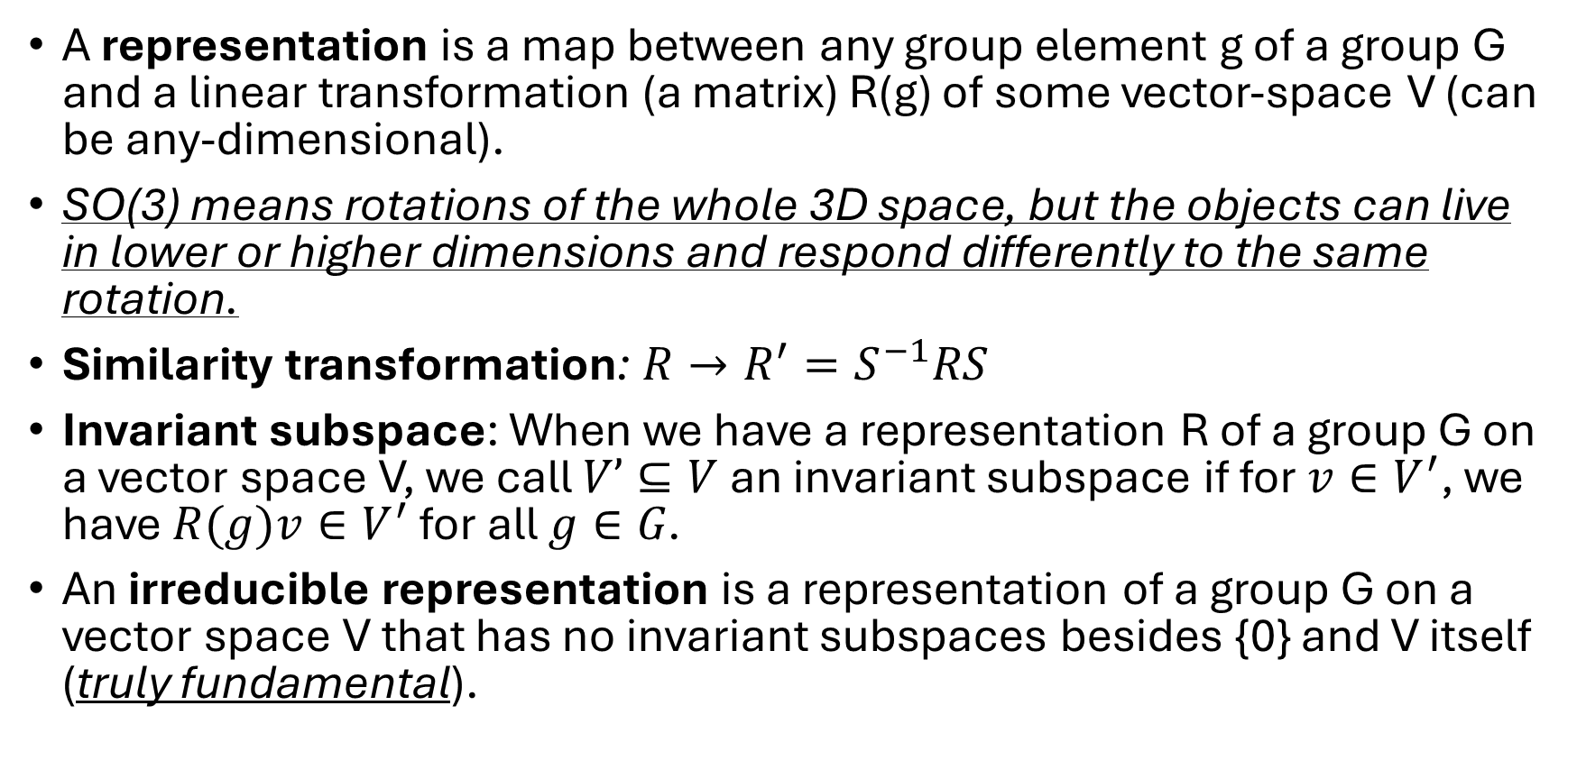
Representation Theory
A representation is a map between any group element g of a group G and a linear transformation (a matrix) R(g) of some vector-space V (can be any-dimensional).
SO(3) means rotations of the whole 3D space, but the objects can live in lower or higher dimensions and respond differently to the same rotation.
Similarity transformation: $R→R^{′}=S^{−1}RS$
Invariant subspace: When we have a representation R of a group G on a vector space V, we call $V’⊆V$ an invariant subspace if for $v∈V^{′}$, we have $R(g)v∈V^{′}$ for all $g∈G$.
An irreducible representation is a representation of a group G on a vector space V that has no invariant subspaces besides {0} and V itself (truly fundamental).

Slide 12
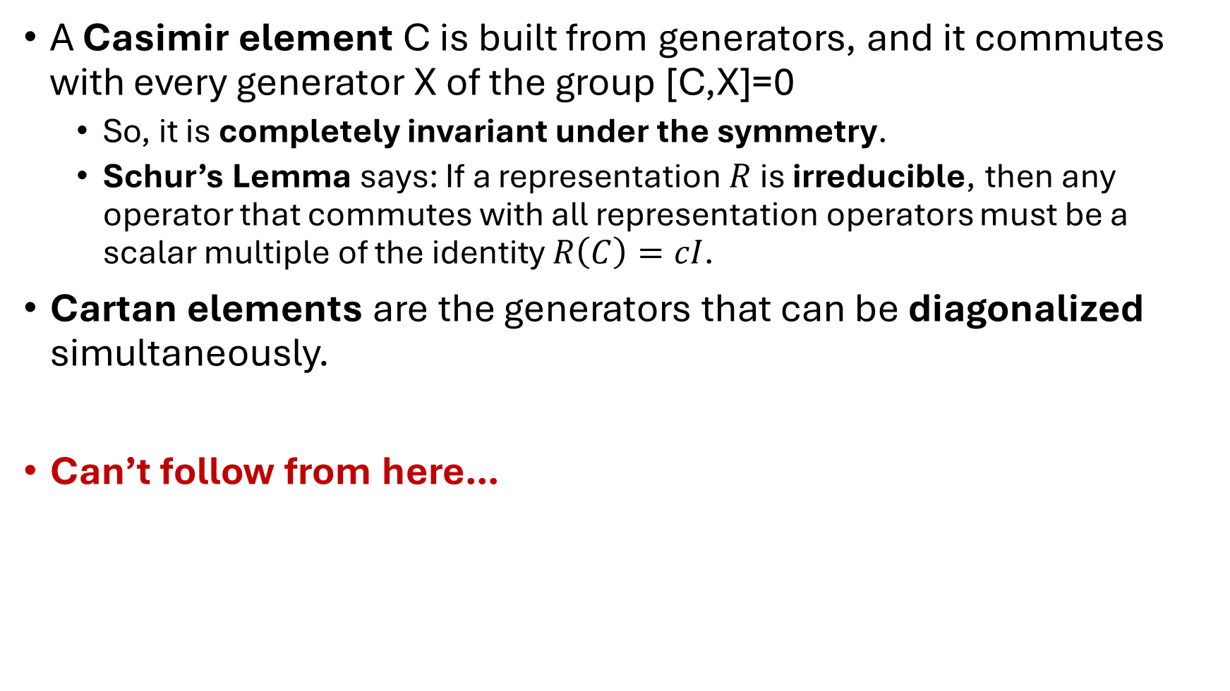
A Casimir element C is built from generators, and it commutes with every generator X of the group [C,X]=0
So, it is completely invariant under the symmetry.
Schur’s Lemma says: If a representation $R$is irreducible, then any operator that commutes with all representation operators must be a scalar multiple of the identity $R\left(C\right)=cI$.
Cartan elements are the generators that can be diagonalized simultaneously.
Can’t follow from here…

Slide 13
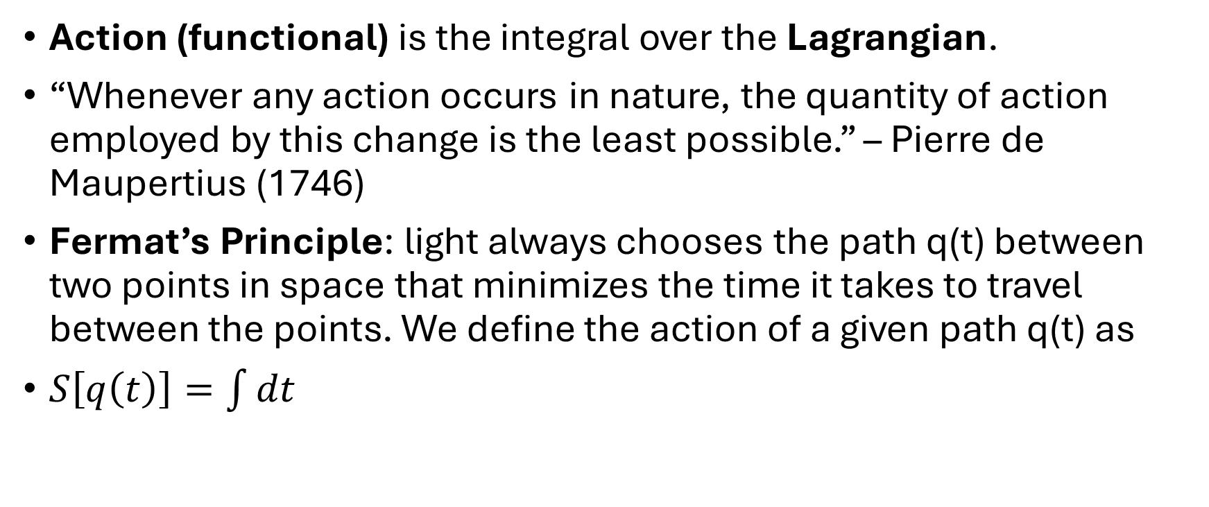
4. The Framework
Action (functional) is the integral over the Lagrangian.
“Whenever any action occurs in nature, the quantity of action employed by this change is the least possible.” – Pierre de Maupertius (1746)
Fermat’s Principle: light always chooses the path q(t) between two points in space that minimizes the time it takes to travel between the points. We define the action of a given path q(t) as
$S\left[q\left(t\right)\right]=\int{dt}$

Slide 14
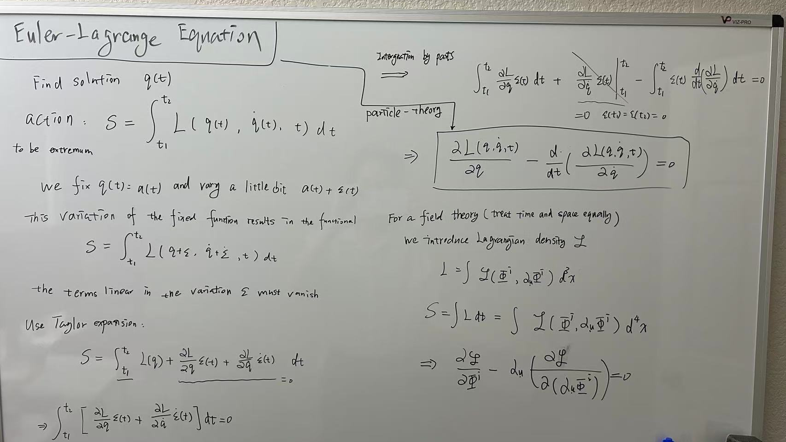

Slide 15
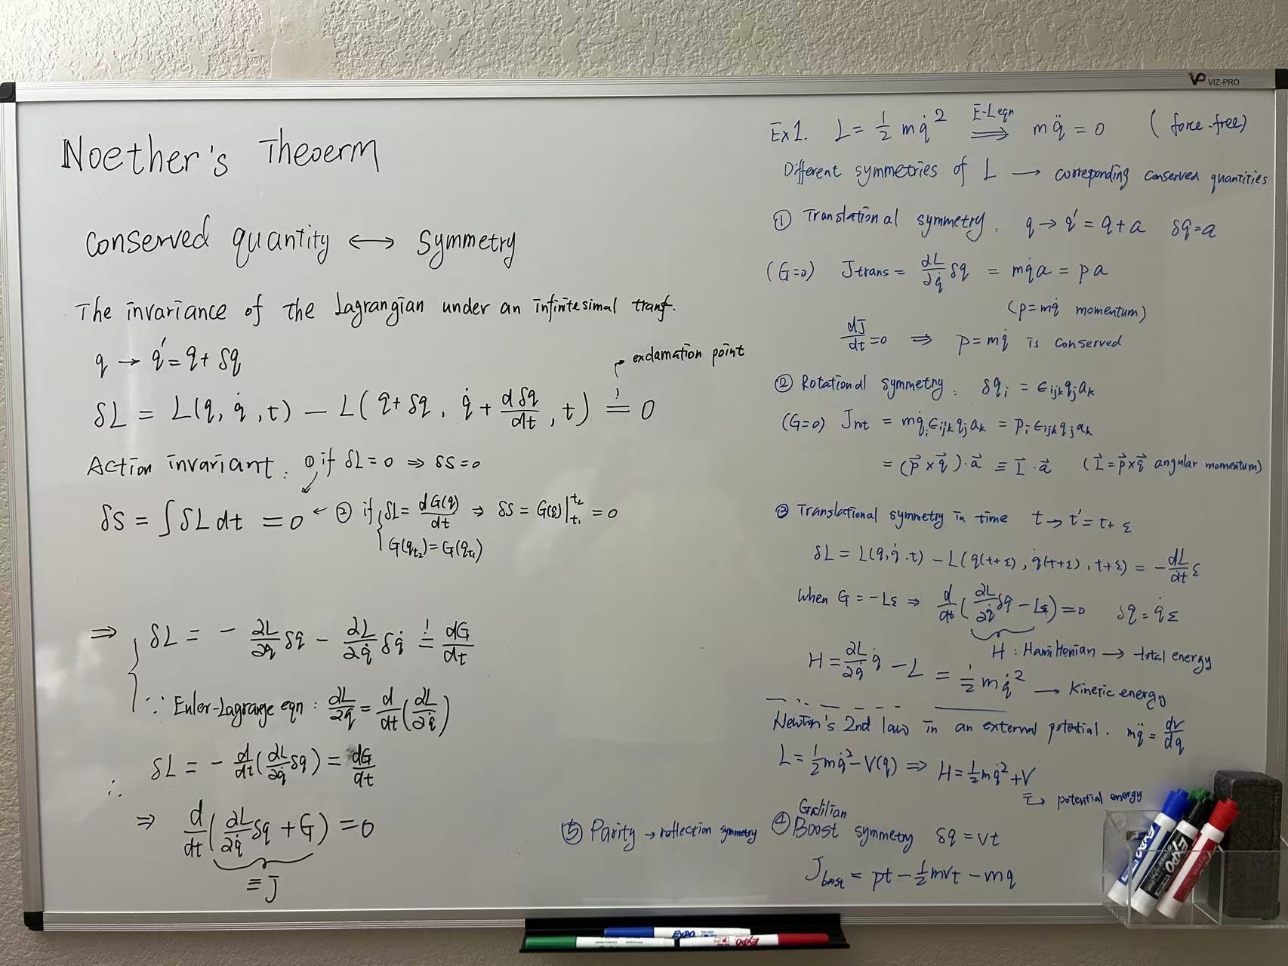
Noether’s theorem

Slide 16
Data-driven dimensional analysis: algorithms for unique and relevant dimensionless groups Paul G. Constantinea , Zachary del Rosariob , Gianluca Iaccarinoc
All empirical models are ridge functions, which are functions that are constant along low-dimensional subspaces in its domain.
a unit is a type of dimension; for example, both meter and foot are types of the dimension length.
dimension reduction (here) means replacing or approximating a function f : R m → R by some other function g : R n → R, where n < m.

Slide 17
A Unified Framework to Enforce, Discover, and Promote Symmetry in Machine Learning
Samuel E. Otto ∗ s.otto@cornell.edu AI Institute in Dynamic Systems University of Washington Seattle, WA 98195-4322, USA Nicholas Zolman nzolman@uw.edu AI Institute in Dynamic Systems University of Washington Seattle, WA 98195-4322, USA J. Nathan Kutz kutz@uw.edu AI Institute in Dynamic Systems University of Washington Seattle, WA 98195-4322, USA Steven L. Brunton sbrunton@uw.edu AI Institute in Dynamic Systems University of Washington Seattle, WA 98195-4322, USA

Slide 18
they illustrate how symmetric models and theories in physics automatically extrapolate in explainable ways to environments beyond the available data.
Task 1. Enforce. Train a model with known symmetry.
Task 2. Discover. Identify the symmetries of a given model or data set.
Task 3. Promote. Train a model with as many symmetries as possible (from among candidates), breaking symmetries only when there is sufficient evidence in the data
Lie derivative associated with fiber-linear Lie group actions on vector bundles.

Slide 19
Data-driven discovery of self-similarity using neural networks
PHYSICAL REVIEW E 111, 024301 (2025)
when the training is successful, we can extract the power exponents that characterize scale-transformation symmetries of the physical problem
data collapse, in which all data points lie on a lowdimensional manifold by choosing the similarity parameters as the axes of the data plot
similarity of the first kind
similarity of the second kind
incorporate symmetry under scale transformations in a parametrized manner;
The identification of self-similarity is equivalent to finding scale-transformation symmetry inherent in the phenomenon of interest.
generators of scale transformations

Slide 20
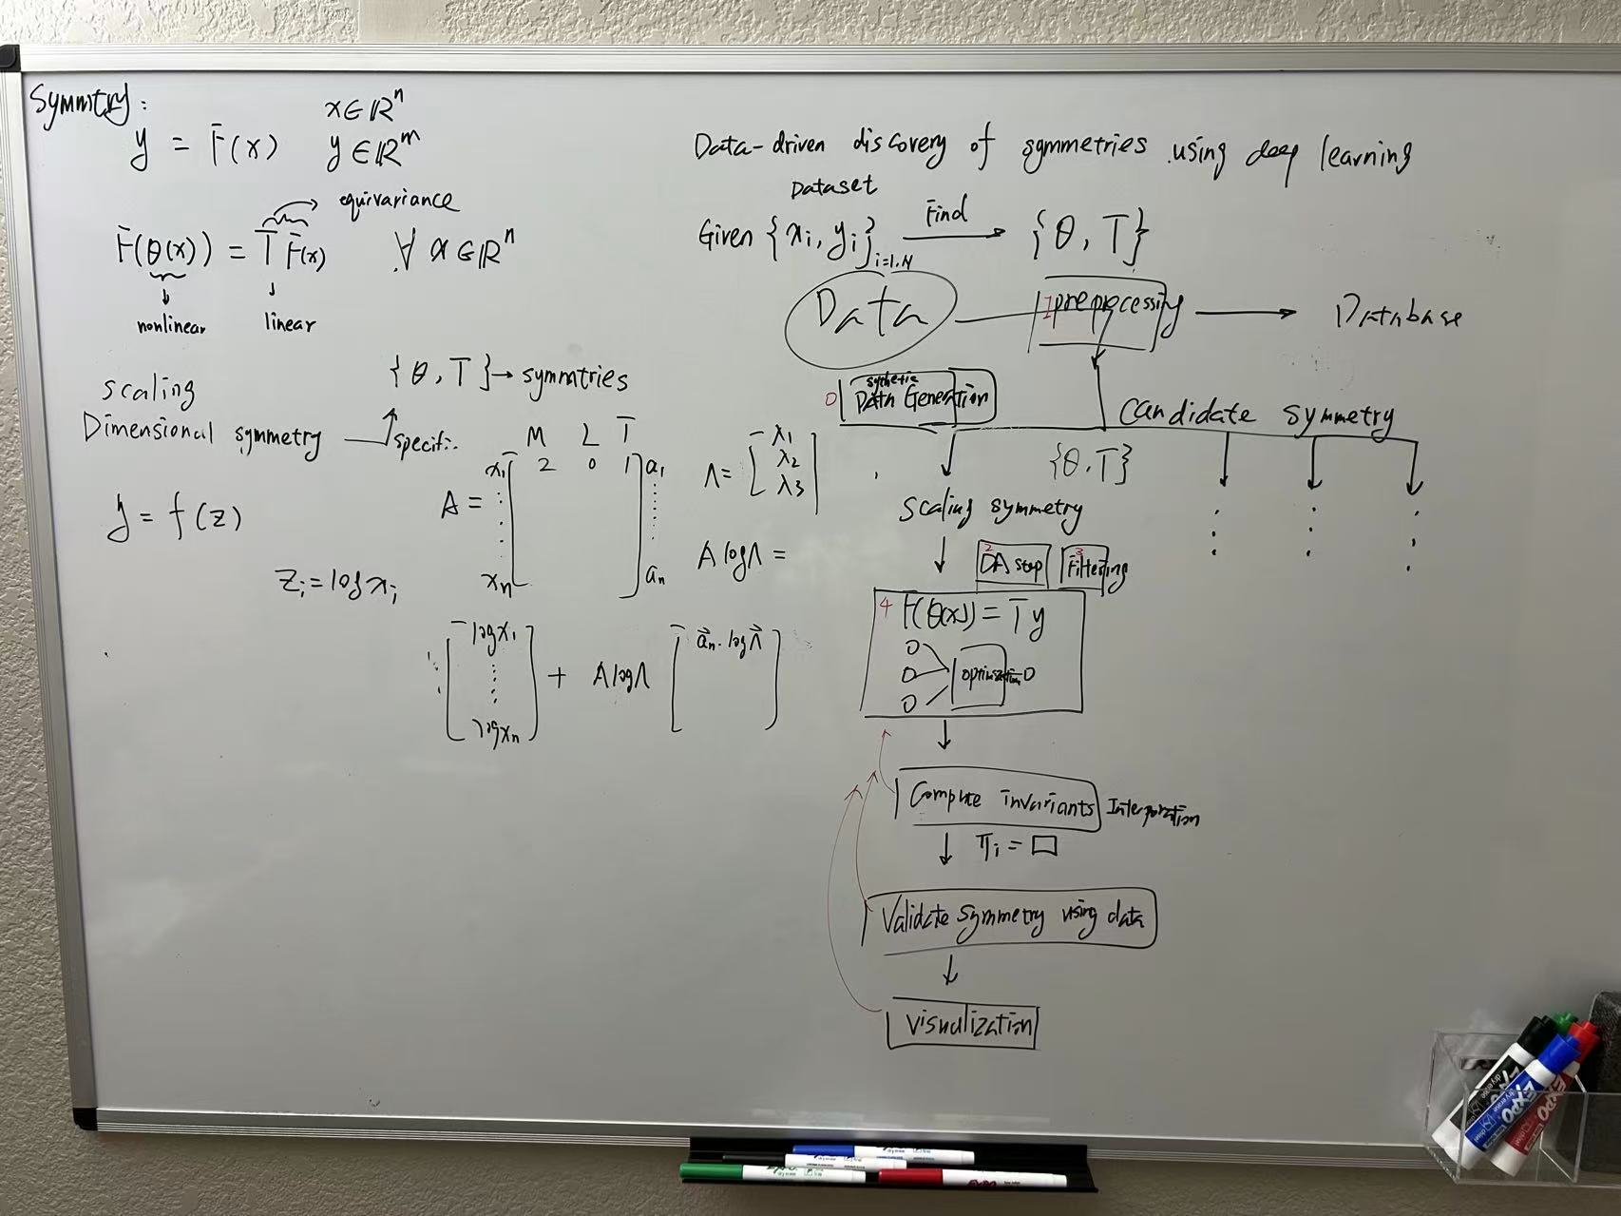
General framework

Slide 21
